Slide 1
MINI PROJECT
Presented by
Krishi Shah (2107012023)
Nandini Khandelwal (2100127031)
Shourya Sharma (21070127048)

Slide 2
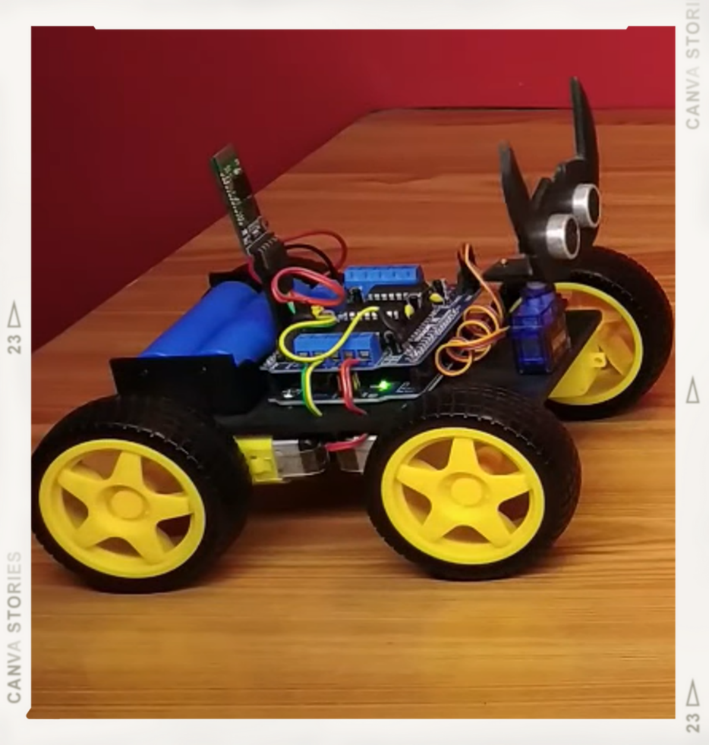
PROJECT 1
ARDUINO VOICE CONTROL CAR

Slide 3
INDEX
Sr. No. | Title | Slide No.
1. | Introduction | 4
2. | Literature Survey | 5
3. | Methodology | 6
4. | Block Diagram | 8
5. | Materials Needed | 9
6. | Contribution | 10

Slide 4
INTRODUCTION
This project Voice Controlled Robotic Vehicle helps to control robots through voice commands received via an android application. The integration of the control unit with a Bluetooth device is done to capture and read the voice commands. The robotic vehicle then operates as per the command received via the android application. The robot can be used as an indoor assistive robot which will act as a pick and place robot and also can be used as an industrial robot.

Slide 5
LITERATURE SURVEY
In this project, we will be making use of Arduino Uno. We will use Arduino Motor Shield which allows you to easily control motor direction and speed using an Arduino. The wheels and TT gear motors will be used to move the robot. A Servo motor will be used for the movement of the head of the robot. Ultrasonic and Infrared sensors will be used for the detection of any object on the way. A Bluetooth module will be used which will get connected to the phone's bluetooth.

Slide 6
METHODOLOGY
The robot will receive the commands in text form from the connected Bluetooth receiver at the end. Initially, the robot will wait for an incoming connection. When available, the text will be parsed character by character to the robot. The Arduino will then build the characters into a single word. A small delay of 100 milliseconds is implemented in building the word, so as to prevent overwriting or loss of any character.

Slide 7
METHODOLOGY
Once the command has been received the Arduino then compares the text to the preprogrammed instruction set as follows:
Slow and Fast Forward and backward.
Sharp Right and sharp right.
Slow Right and Slow Left:
Zigzag: Activates both motors alternatively to move forward in a zig-zag pattern. j.
Stop: Deactivates both motors.

Slide 8
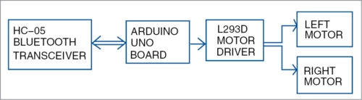
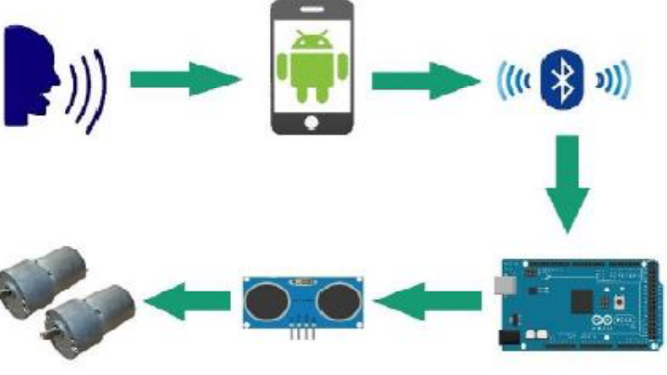
BLOCK DIAGRAM

Slide 9
MATERIALS NEEDED
1) Arduino Uno - 815
2) Motor Driver Shield - 270
3) Wheels (4x) & TT Gear Motor (4x) - 450
4) Servo Motor - 235
5) Ultrasonic Sensor - 241
6) Infrared Sensor (2x) - 170
7) 18650 Li-on Battery (2x) - 100
8) 18650 Battery Holder - 89
9) Male and Female Jumper wire - 230
10) Acrylic Sheet - 100
11) DC Power Switch - 150
12) HC-05 Bluetooth Module - 400
Total = 3300

Slide 10
CONTRIBUTION
Krishi - Code, Wire Connection, Laser Cutting of Models Parts
Nandini - Code, Wire Connection, Laser Cutting of Models Parts
Shourya - Code, Wire Connection, Laser Cutting of Models Parts

Slide 11
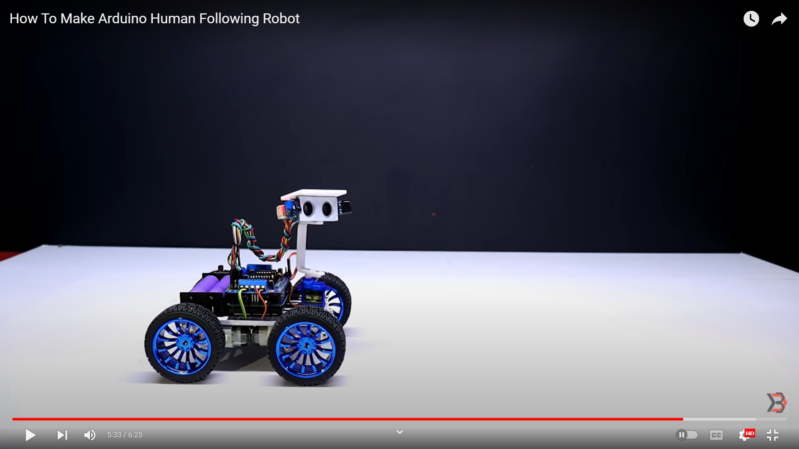

PROJECT 2
ARDUINO HUMAN FOLLOWING ROBOT

Slide 12
INDEX
Sr. No. | Title | Slide No.
1. | Introduction | 13
2. | Literature Survey | 14
3. | Methodology | 15
4. | Block Diagram | 16
5. | Materials Needed | 17
6. | Contribution | 18

Slide 13
INTRODUCTION
Human following is a technique used by robots and autonomous vehicles to follow a human within a specific range.
A human following robot is a bot that follows a human on detecting it. The robot should also be able to exhibit effective obstacle avoidance with target following and exploration behaviors. The human follower robot can help us in a domestic environment as well as in an industrial area.

Slide 14
LITERATURE SURVEY
In this project, we will be making use of Arduino Uno. We will use Arduino Motor Shield which allows you to easily control motor direction and speed using an Arduino. The wheels and TT gear motors will be used to move the robot. A Servo motor will be used for the movement of the head of the robot. Ultrasonic and Infrared sensors will be used for the detection of any object on the way.

Slide 15
METHODOLOGY
This robot uses ultrasonic range sensors and Infrared sensors. The test was performed on the both ultrasonic sensor and the infrared sensor and the sensor was working accurately within the range of 10 cm. An ultrasonic sensor is used to move the robot forward and backward. Infrared sensors are used to move the robot in the left or right direction accordingly. Then we test the serial communication of Arduino, motor shield, and various motors.

Slide 16
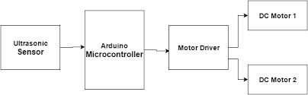
BLOCK DIAGRAM

Slide 17
MATERIALS NEEDED
1) Arduino Uno - 815
2) Motor Driver Shield - 270
3) Wheels (4x) & TT Gear Motor (4x) - 450
4) Servo Motor - 235
5) Ultrasonic Sensor - 241
6) Infrared Sensor (2x) - 170
7) 18650 Li-on Battery (2x) - 100
8) 18650 Battery Holder - 89
9) Male and Female Jumper wire - 230
10) Acrylic Sheet - 100
11) DC Power Switch - 150
Total = 3000

Slide 18
CONTRIBUTION
Krishi - Code, Wire Connection, Laser Cutting of Models Parts
Nandini - Code, Wire Connection, Laser Cutting of Models Parts
Shourya - Code, Wire Connection, Laser Cutting of Models Parts

Slide 19
THANK YOU

